Slide 1
WORM
By
Mohamed Amine Dherifa

Slide 2

Worm: Autonomous Propagation Without Interaction
Introduction
This presentation will explore the worWorm attack, a form of autonomous propagation in cybersecurity. We will delve into its mechanisms, targets, and potential impact.

Slide 3
Presentation Objectives
Objectives:
Understand the definition and principles of the WorWorm attack.
Identify the technical steps involved in its execution.
Learn about the vulnerabilities exploited and the consequences of the attack.
Explore countermeasures and lessons learned for prevention and response.

Slide 4

Context and Description of the Attack
General Context
The worWorm attack represents a significant threat due to its ability to spread autonomously without human interaction. Understanding this attack is crucial for cybersecurity professionals and students alike.

Slide 5

Definition and General Principle
Definition
The worWorm attack is a type of malware that can propagate autonomously across networks by exploiting vulnerabilities in target systems. It requires minimal to no human intervention to spread.
General Principle
The core principle is to identify and exploit vulnerabilities in a system to gain unauthorized access, then replicate and spread to other vulnerable systems.

Slide 6

Preferred Targets
Target Systems: WorWorms typically target systems with known vulnerabilities or weak security configurations, such as:
Unpatched servers
IoT devices with default credentials
Network devices with outdated firmware

Slide 7

Technical Steps - How the Attack is Carried Out
The attack involves a series of technical steps, starting with reconnaissance, followed by exploitation, propagation, and maintenance of access.

Slide 8

Preparation (Reconnaissance Phase)
Reconnaissance: Attackers gather information about potential targets through:
Network scanning: Identifying open ports and services.
Vulnerability scanning: Detecting known vulnerabilities in software and hardware.
Information gathering: Collecting publicly available information about the target organization.

Slide 9

Execution of the Attack
Step 1: Initial Exploitation: The attacker exploits a known vulnerability to gain initial access to the target system. This could be done through:
SQL injection: Injecting malicious SQL code to bypass authentication.
Remote code execution: Executing arbitrary code on the target system.
Example Command: nmap -v -A target_ip (for network scanning)

Slide 10

Execution of the Attack
Step 2: Propagation: Once inside, the worWorm replicates itself and spreads to other vulnerable systems on the network. This involves:
Scanning the network: Identifying other potential targets.
Exploiting similar vulnerabilities: Using the same or different exploits to compromise additional systems.
Step 3: Payload Delivery: After gaining access to multiple systems, the worWorm delivers its malicious payload. This could include:
Data theft: Stealing sensitive information from compromised systems.
System disruption: Causing denial-of-service attacks or system crashes.
Malware installation: Installing additional malware for long-term control.

Slide 11
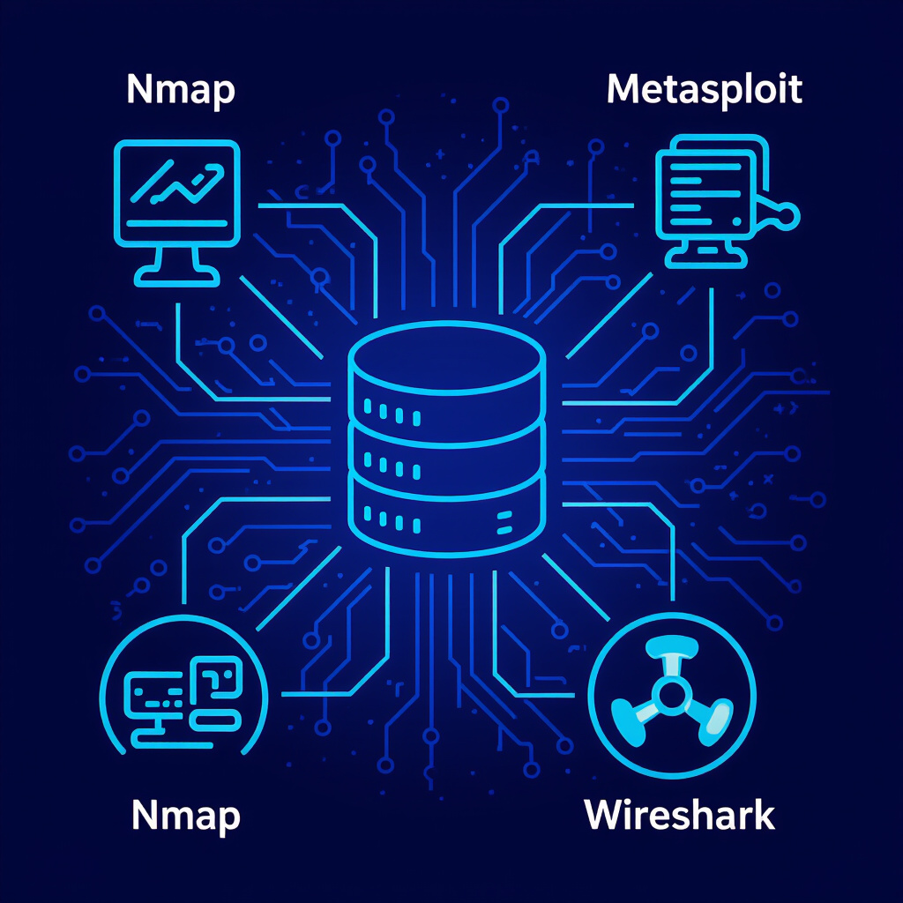
Commands/Tools Used
Common Tools:
Nmap: For network scanning and service discovery.
Metasploit: For vulnerability exploitation and payload delivery.
Wireshark: For network traffic analysis.
Example Command: msfconsole (to launch Metasploit)

Slide 12

Maintaining Access and Exfiltration
Maintaining Access: Attackers ensure continued access to compromised systems by:
Installing backdoors: Creating hidden entry points for future access.
Creating rogue accounts: Establishing new user accounts with administrative privileges.
Data Exfiltration: Data is exfiltrated using various methods:
FTP: Transferring files to an external server.
HTTP: Sending data through web traffic.
Email: Sending data as attachments.

Slide 13

Vulnerabilities Exploited
Nature of Vulnerabilities: WorWorms exploit a range of vulnerabilities, including:
Software bugs: Flaws in software code that can be exploited.
Configuration errors: Misconfigured systems that expose sensitive information.
Weak passwords: Easily guessable passwords that allow unauthorized access.
Attack Vectors: Common attack vectors include:
Phishing: Tricking users into revealing credentials or downloading malware.
Drive-by downloads: Infecting systems through compromised websites.
Social engineering: Manipulating individuals to gain access to systems or information.

Slide 14
Consequences and Damage Caused
Technical Impact
Operational Impact
Financial Impact
System compromise: Unauthorized access to sensitive systems. Data breaches: Theft or exposure of confidential data. Network disruption: Downtime and performance degradation.
Business interruption: Disruption of critical business processes. Reputational damage: Loss of customer trust and brand value.
Recovery costs: Expenses associated with incident response and system restoration. Legal and compliance costs: Fines and penalties for regulatory violations.

Slide 15
Countermeasures and Lessons Learned
Detection of the Attack
Preventive Measures
Response and Recovery Measures
Network monitoring: Monitoring network traffic for suspicious activity. Intrusion detection systems (IDS): Identifying and alerting on malicious behavior. Log analysis: Reviewing system logs for signs of compromise.
Patch management: Regularly updating software and firmware to address known vulnerabilities. Strong passwords: Enforcing strong password policies. Network segmentation: Isolating critical systems from less secure networks.
Incident response plan: A documented plan for responding to security incidents. System restoration: Restoring compromised systems from backups. Forensic analysis: Investigating the attack to determine the root cause and extent of the damage.

Slide 16


Conclusion
Summary of Key Points
WorWorm attacks are a significant threat due to their autonomous propagation, exploiting vulnerabilities in target systems. This leads to system compromise, data breaches, and financial losses. Effective countermeasures include detection, prevention, and response measures to mitigate these risks.
Developments and Future Trends
Emerging trends include AI-powered worWorms that enhance attack effectiveness, and IoT-focused attacks targeting vulnerable devices. Additionally, there is increasing sophistication in techniques used to evade detection, making it crucial to stay ahead with advanced security measures.

